Slide 1
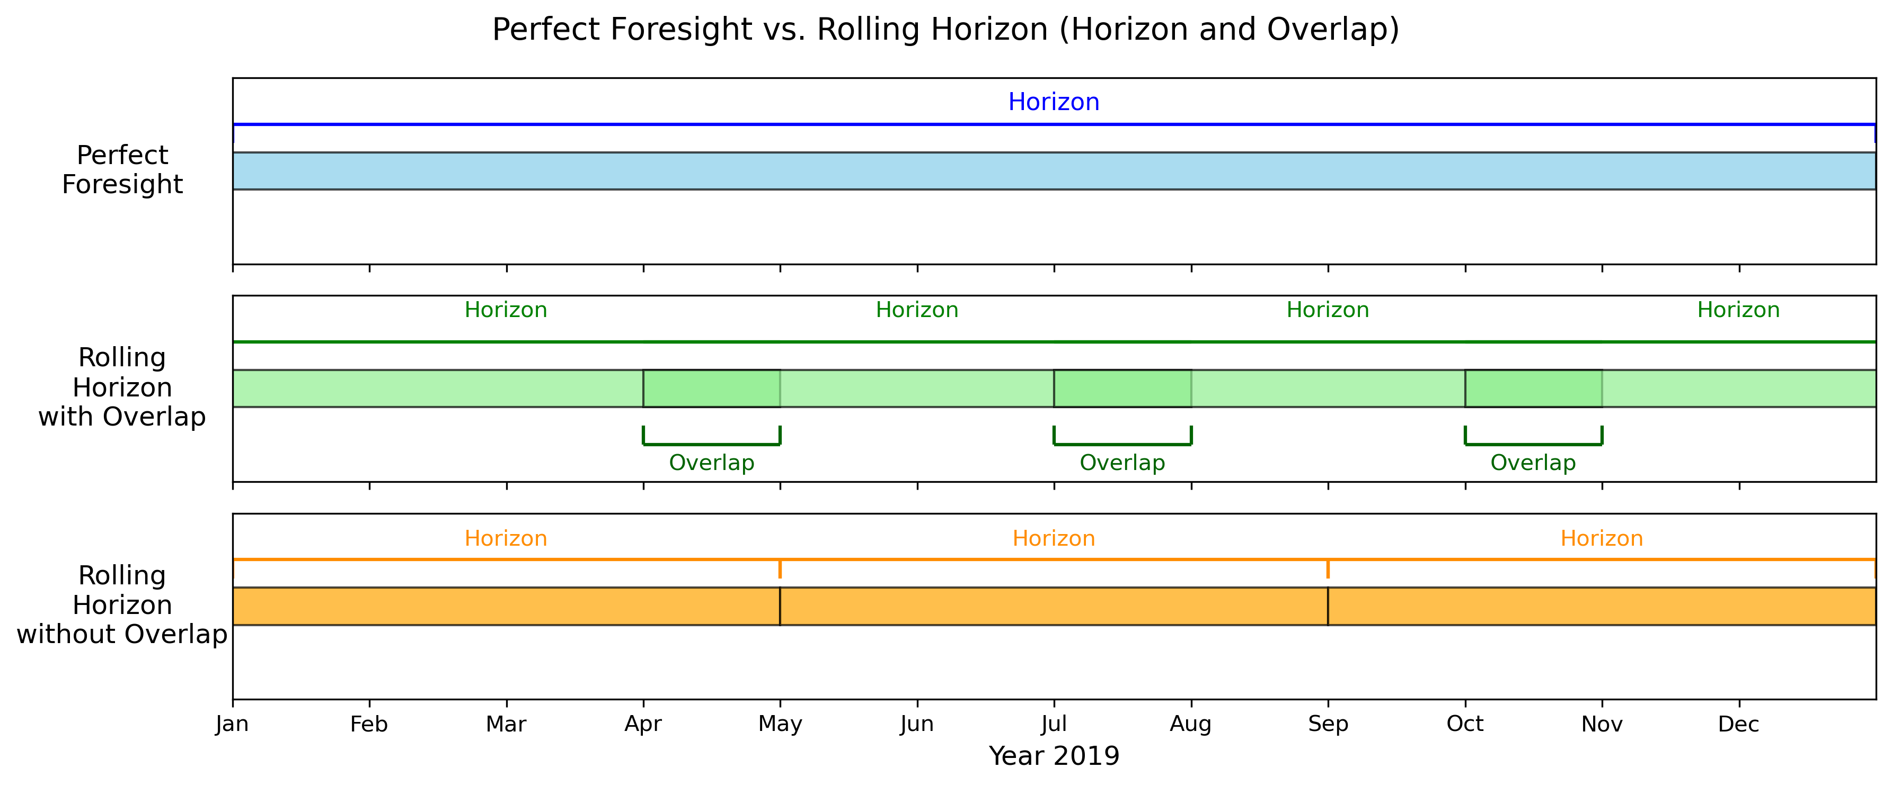
Perfect Foresight vs. Myopic Foresight
Horizon
Horizon
Horizon
Horizon

Slide 2
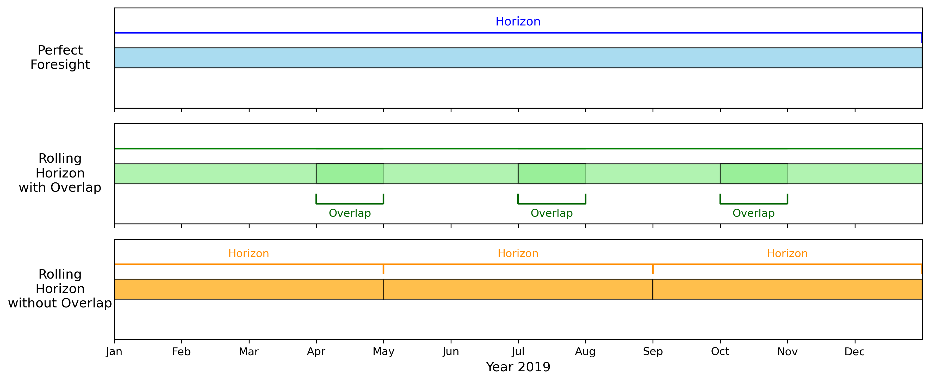
Horizon
Horizon
Horizon
Horizon

Slide 3





1. Wind and Solar Forecasts
2. Electricity Price
Generation
3. Stochastic Battery Storage Profit Optimization
4. Re-Implementation of
the Operating Strategy

